Slide 1
HIMSS23 Registration Demographics as of 04/23/2023

Slide 2
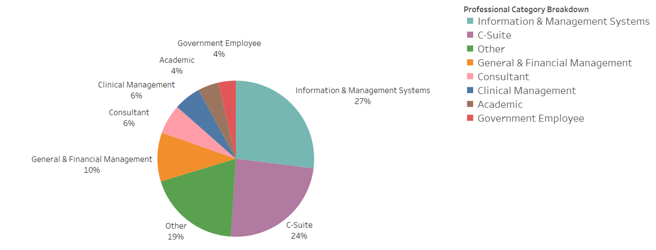
Professional Title Breakdown*
*All Registered Professional Attendees
As of 4.03.23

Slide 3
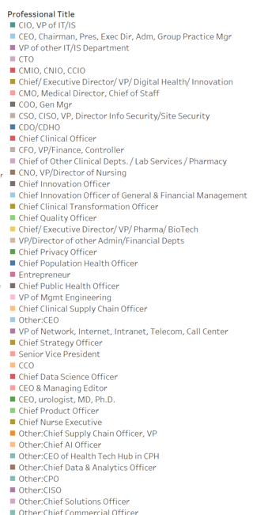
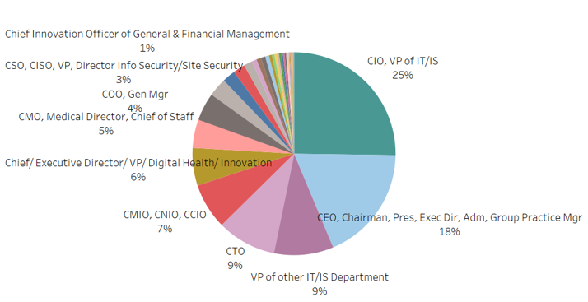
C-Suite Breakdown*
*All Registered Professional Attendees
As of 4.03.23

Slide 4
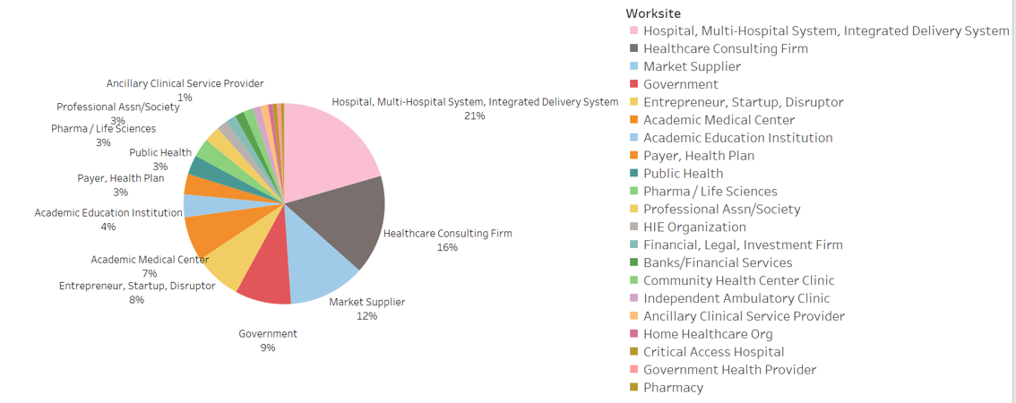
Worksite Breakdown *
*All Registered Professional Attendees
As of 4.03.23

